Slide 1
Designing an A/B Test Experiment
Norfolk Data Science | 19th Nov, 2019 | Raja Harsha

Slide 2
A/B Testing
Every business process has a conversion metric to evaluate.
Whenever we release a new online product or a drug, given two sets of groups and see if the changes really benefited through statistical tests.
A/B testing is an experiment where two or more variants are exposed to 2 environments and statistical analyze which variant performs better for a given conversion goal.

Slide 3
Examples
Google tested 41 shades of Blue in their user interface.
Amazon launched its first personalized product recommendation feature based on the A/B test showing a huge revenue increase by adding that feature.
Amazon and Google determined that every 100ms increase in page load time decreased sales (1% for Amazon).
LinkedIn/Fb uses to prioritize a type of news feed (contact suggestion or news).

Slide 4
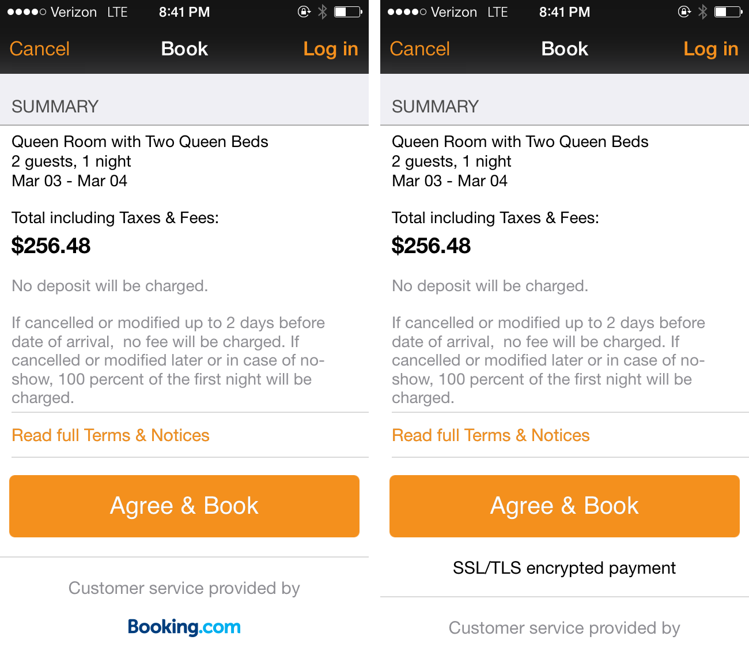
Kayak Use-case
H0: Industry believes that showing the security issue at the payment page in an app will decrease the conversions.
H1: The conversion rate will improve if we display the security message.
Solution: To perform A/B test and find out which is better and come to your own conclusions.
https://apptimize.com/blog/2014/03/kayaks-most-interesting-ab-test/

Slide 5
Hypotheses
Sample Hypotheses: Market A business is better than B.
Null hypothesis: No difference
H0: μ1 = μ2
Alternative Hypothesis: More likely to have difference.
H1 : μ1 ≠ μ2

Slide 6
Common Hypothesis Tests
T-test: Compare means of continuous variables.
Chi-square: Examine proportions of discrete categories.
Fisher exact test: Examine proportions of discrete categories.
Pearson test: Examine if continuous variables are correlated.

Slide 7
T-test
Check for statistical significance for continuous (normal, t, binomially distributed) data.
Ex: Test for user click behaviour
Advertisement ID | User Click
B | 1
B | 1
A | 0
B | 0
A | 1

Slide 8
Chi-sQUARE TEST
Check statistical significance within categorical data where we have summary metrics like counts or rates.
Ex: Test for user click-through rates
 | Sum(User Clicks) | Sum(No User Clicks)
Advertisement A | 36 | 14
Advertisement B | 30 | 25

Slide 9
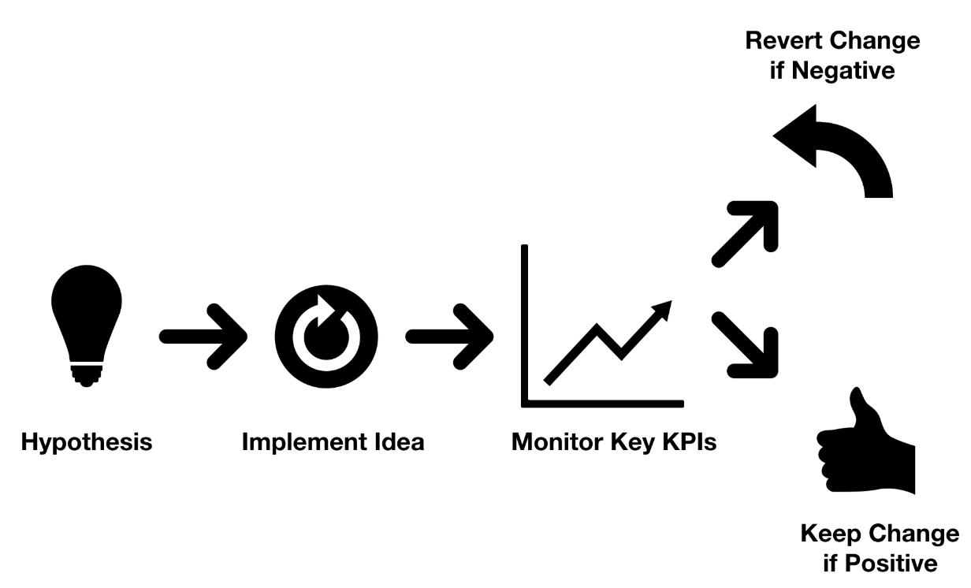
A/B TEsting Flow

Slide 10
EXample Conversion Metrics
CR - Conversion Rate
CTR - Click Through Rate
TPV - Time Per Visitor
RPV - Revenue Per Visitor
CTA - Call to Action

Slide 11
aPproach 1
Step 1: Come up with an idea and determine lift threshold.
Step 2: Determine sample size needed given your company’s standard error rates.
Step 3: Run the test, monitor and turn off when you reach sample size.
Step 4: Run your statistical test.

Slide 12
aPproach 2
Step 5: If the p value is under the critical value, reject the null hypothesis.
Step 6: If the p value > critical value, do not reject the null hypothesis.
Step 7: If you rejected null hypothesis, push winner
Step 8: If you did not reject the null hypothesis, re-test going bigger with this concept or move on to different factor to test.

Slide 13
When do you go for a CHANGe?
It depends on the industry as all changes require some effort/investment.
The business should take a call based on the significance of improvement proves to bring using the statistical tests.
Also, the repeatability of the test results is important to assert more confidence in results.

Slide 14
Important Things & Challenges
Consistent data b/w control and experimental group.
Doing A/B testing on online data is different from the medical field(more controlled environment).
Length to conduct the experiment.
We cannot really test on fresh products.
Novelty effect.

Slide 15
Resources
http://camdavidsonpilon.github.io/Probabilistic-Programming-and-Bayesian-Methods-for-Hackers/
https://www.countbayesie.com/
Simple Examples:
https://medium.com/@sasidhar.konda/ab-testing-in-python-1b5608207d86
https://towardsdatascience.com/the-math-behind-a-b-testing-with-example-code-part-1-of-2-7be752e1d06f
https://www.exp-platform.com/Documents/GuideControlledExperiments.pdf

